Slide 1
Reflow_回焊爐Arduino 方案 SOP
Hector – IBDO DT
20190730

Slide 2
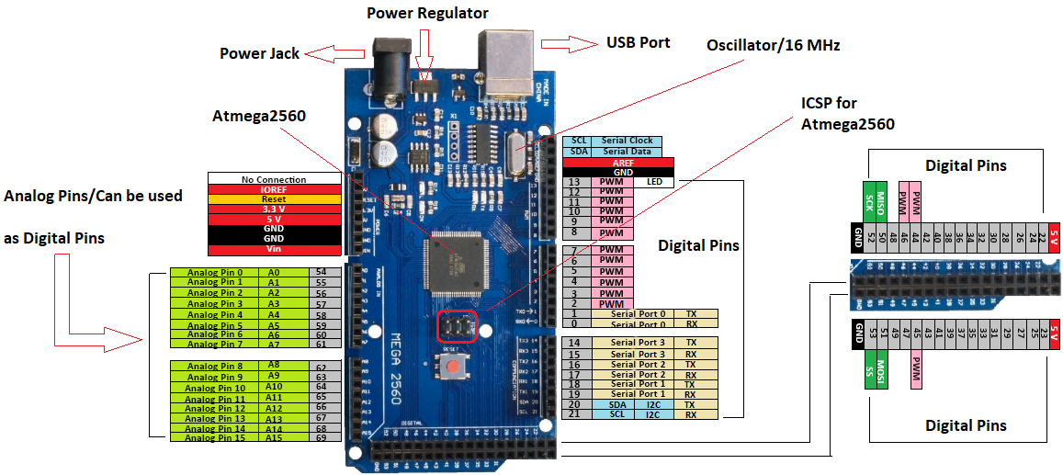
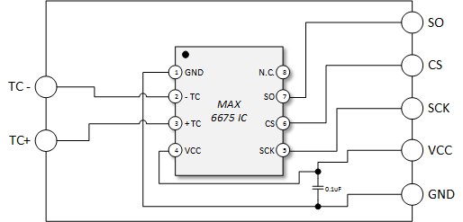
Arduino & MAX6675 wiring
CS pins of each MAX6675 can connect individually to Arduino pins 22~53
SO pins from MAX6675 connect together and connect to Arduino Mega pin 12
SCK pins from MAX6675 connect together and connect to Arduino Mega pin 13
Vcc pins from MAX6675 connect together and connect to Arduino Mega pin Vcc 5V
GND pins from MAX6675 connect together and connect to Arduino Mega pin GND

Slide 3
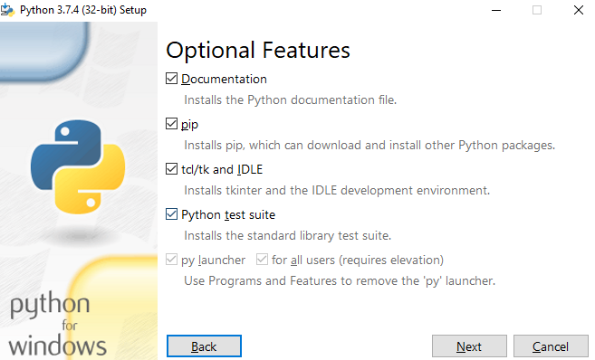
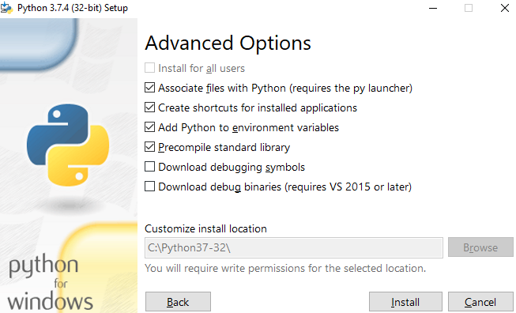
Install Python 3.7
Remember this path

Slide 4
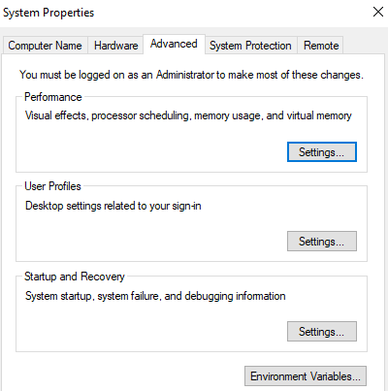
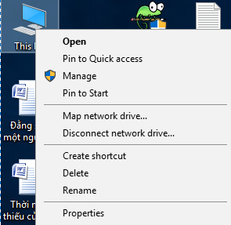
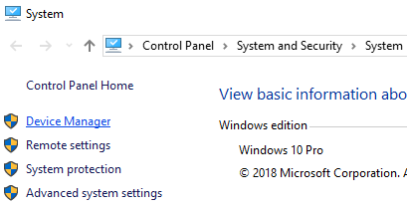
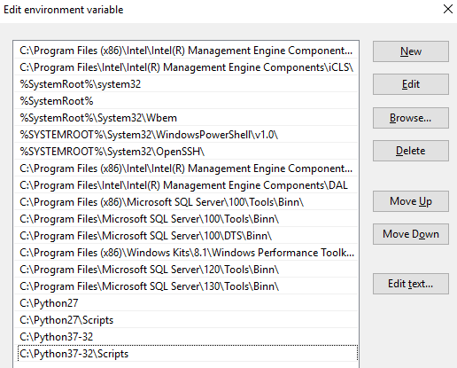
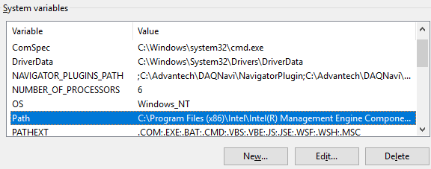
Add python path to PC system path
Press New and add python path,
press OK

Slide 5
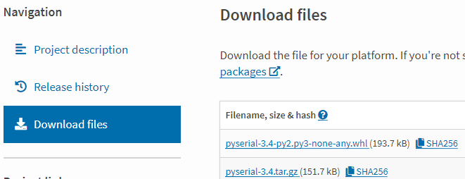
Install pyserial
Open CMD, type: cd C:\Python37-32\pyserial-3.4 (It depends on your PC python path).
. Then type setup.py install
Download pyserial-2.6.tar.gz on the internet. (https://pypi.org/project/pyserial/#files). Then uncompress it by 7-zip or winrar. Copy the folder pyserial-3.4 to python path as you installed in page 3.

Slide 6
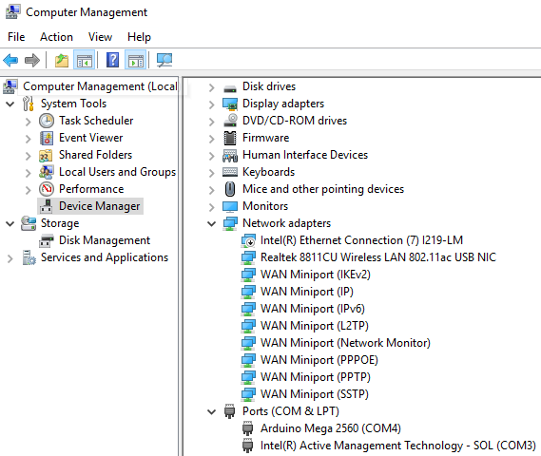
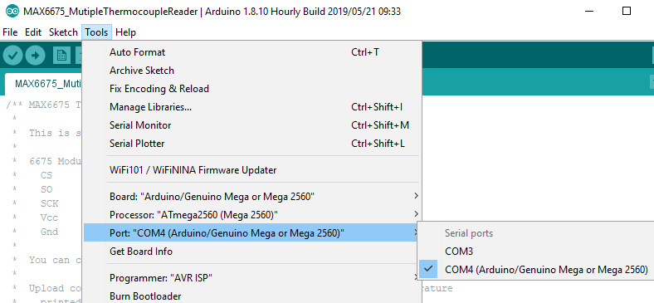
Communicate between Arduino & PC
Open Computer management →Device Manager
In my PC, Arduino is connected to COM4 port. So I can set COM4 in Arduino IDE. You must change COM port settings in Arduino IDE
according to your PC status.

Slide 7

Data acquisition by python
Factory members can copy my python code to do the COM port settings by themselves.
In my PC, I can set it to COM4.
But if your Arduino connects to PC COM5. You must change it to
ser = serial.Serial('COM5', 9600).
After changing COM settings in my python code, save it.

Slide 8
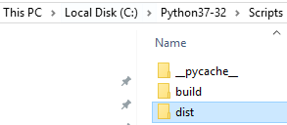
Generate .exe file from python code
Use CMD move to the path C:\Python37-32\Scripts
Type pip install pyinstaller
Then copy my python code to Scripts folder.
Use CMD to generate exe file. E.g. my python file name is Reflow_csv. So you must use this CMD command: pyinstaller --additional-hooks-dir=. Reflow_csv.py
Exe file will be generated in dist folder
In the future, you just need to connect Arduino to PC via USB port then run exe file to collect data in csv files every hour.

